Slide 1


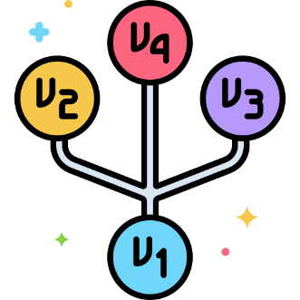

Table of Contents
Configurations
Empty project
Save work to repository
Points for discussion

Slide 2
Git
Basic Configurations

Slide 3
Basic Configurations
Savan@Savan MINGW64 /c/Drive/TermWork/Website
$ git config --global user.name “Your Name”
Savan@Savan MINGW64 /c/Drive/TermWork/Website
$ git config --global user.email “youremail@domain.com”
Git Bash

Slide 4
Basic Configurations
Savan@Savan MINGW64 /c/Drive/TermWork/Website
$ git config --global user.name “Your Name”
Savan@Savan MINGW64 /c/Drive/TermWork/Website
$ git config --global user.email “youremail@domain.com”
Savan@Savan MINGW64 /c/Drive/TermWork/Website
$ git config --global –list
user.email=savanpatel5248@gmail.com
user.name=Savan Sutariya
Git Bash

Slide 5
Git
How to save a Change?

Slide 6
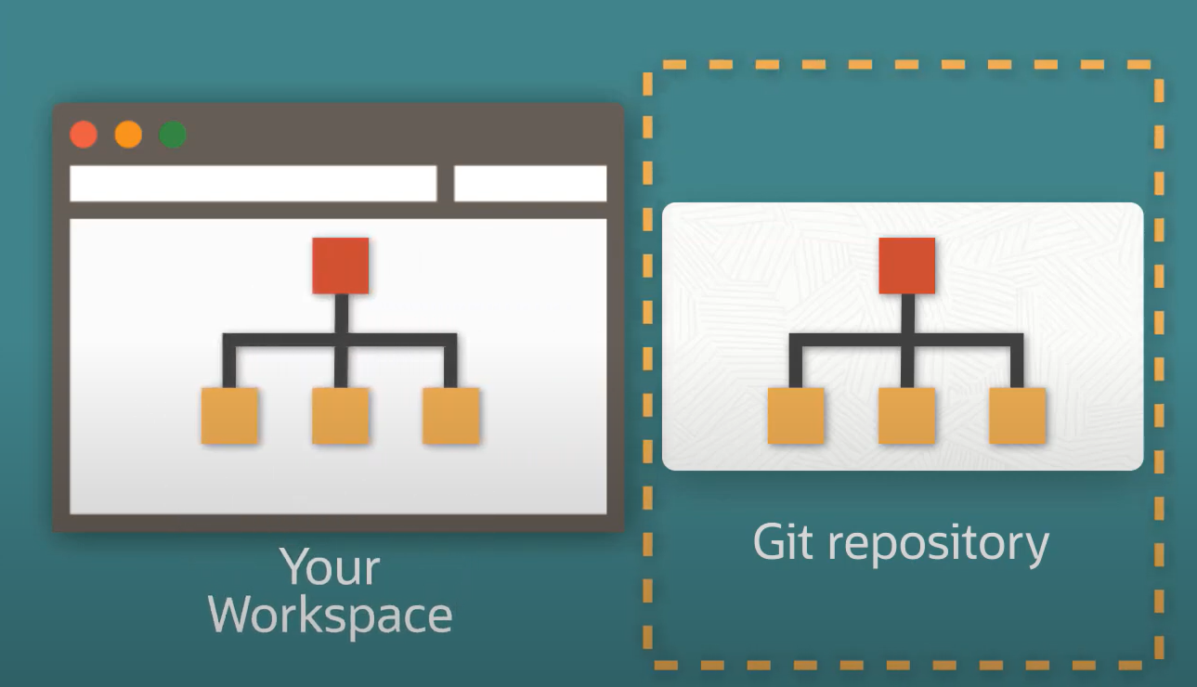
Repository and Working Directory

Slide 7
Savan@Savan MINGW64 /c/Drive/TermWork/Website
$ git init
Initialized empty Git repository in C:/Drive/Study/MCA/DDU/SEM_2/Seminar/Demo_TODO/.git/
Savan@Savan MINGW64 /c/Drive/TermWork/Website
$ touch README.MD
Repository and Working Directory

Slide 8
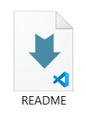
Savan@Savan MINGW64 /c/Drive/TermWork/Website
$ git init
Initialized empty Git repository in C:/Drive/Study/MCA/DDU/SEM_2/Seminar/Demo_TODO/.git/
Savan@Savan MINGW64 /c/Drive/TermWork/Website
$ touch README.MD
Repository and Working Directory

Slide 9
Empty
Savan@Savan MINGW64 /c/Drive/TermWork/Website
$ git init
Initialized empty Git repository in C:/Drive/Study/MCA/DDU/SEM_2/Seminar/Demo_TODO/.git/
Repository and Working Directory
Savan@Savan MINGW64 /c/Drive/TermWork/Website
$ touch README.MD

Slide 10
Git
Git states

Slide 11

Staging area
Empty
Untracked
Stage files
Commit
Remove the file
Untracked

Slide 12
Staging area
Empty
Untracked
Stage files
$ git add README.MD
Commit
Staging area
Remove the file

Slide 13
Empty
Untracked
Staging area
Commit
Stage files
Commit
Remove the file
Staging area

Slide 14
Empty
Untracked
Staging area
Commit
Stage files
$ git commit –m “Initial commit”
Commit
Remove the file
Commit

Slide 15
Untracked
Staging area
Git repository
Stage files
Commit
Commit made

Slide 16
Untracked
Staging area
Git repository
Stage files
Commit
Commit

Slide 17
Untracked
Staging area
Git repository
Stage files
Commit
Commit

Slide 18
Untracked
Staging area
Git repository
Stage files
Commit
Remove the file
Commit

